Slide 1
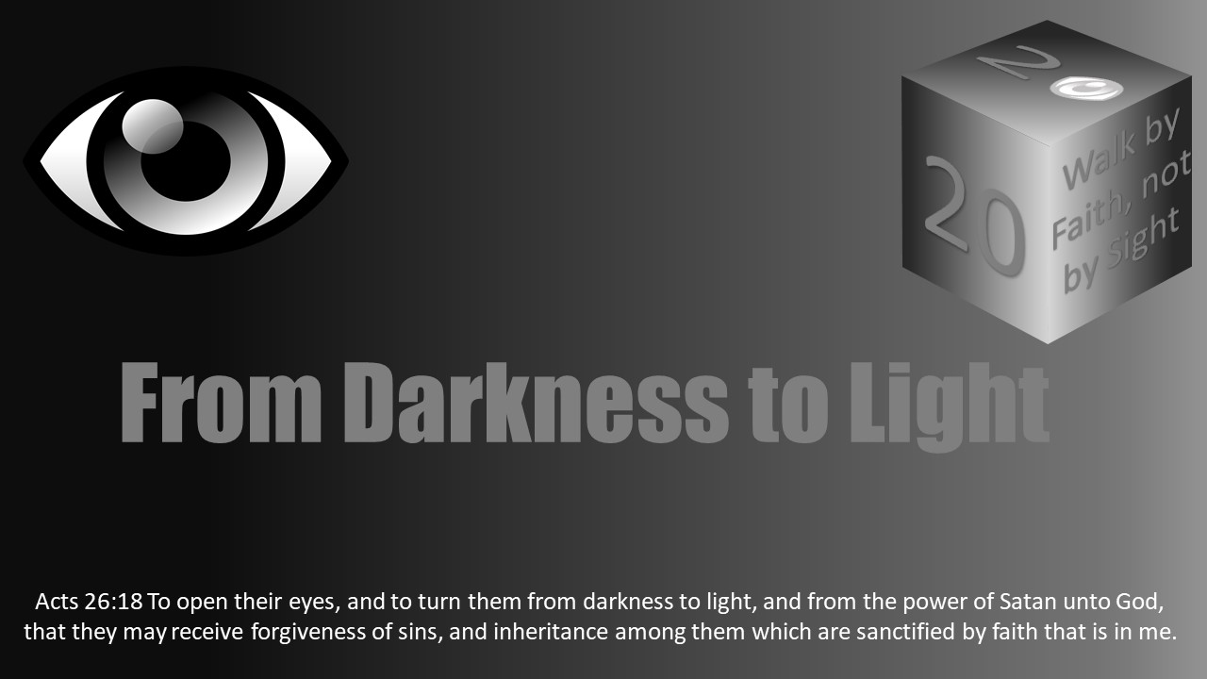


Slide 2
Dark Lesson 23 - Lust of The Eyes: Covetousness, Greed, Mammon

Slide 3

Introduction
The lust of the eyes is about greed.
1 John 2:15-17 warns, "Love not the world, neither the things that are in the world. If any man love the world, the love of the Father is not in him. For all that is in the world, the lust of the flesh, and the lust of the eyes, and the pride of life, is not of the Father, but is of the world. And the world passeth away, and the lust thereof: but he that doeth the will of God abideth for ever.”
Thus, the way of Balaam or greed remains one of the most powerful influences in time.

Slide 4
Introduction
Christ taught in Matthew 6:22-25:
“The lamp of the body is the eye. If therefore your eye is good, your whole body will be full of light. “But if your eye is bad, your whole body will be full of darkness. If therefore the light that is in you is darkness, how great is that darkness! “No one can serve two masters; for either he will hate the one and love the other, or else he will be loyal to the one and despise the other. You cannot serve God and mammon.”
Mammon is wealth or possessions that exert an evil influence or is a false object of worship and devotion.
Greed is one of Satan’s tools to blind to the spiritual and eternal.

Slide 5
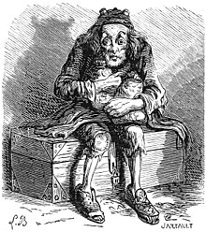
Greed (covetousness) Defined
Greed is “an excessive desire to acquire or possess, as wealth, or power, beyond what one needs or deserves.” (AHD)
”We’re all born brave, trusting, and greedy, and most of us remain greedy.” Mignon Claughlin
Miserly Scrooge in A Christmas Carol, as an example, embodies greed in attitude as well as all that it cost him.
Although many are greedy without being miserly, more than ever, our society has a problem distinguishing between needs and greeds.
Greed is a powerful blinder of one's spiritual sight and one of Satan's most powerful dark distortions.

Slide 6

Greed Defined
Greed is the desire or longing for something that creates a willingness to do whatever is required to acquire the object of desire. (More than $, envy, power, joke)
The object of desire can be power, fame, even sexual gratification (eg King David regarding Bathsheba); but it is most often money and material possessions.
Greed, in short, is idolatry (See Col 3:5-6).
It puts God’s plan and direction for life on hold for one’s own desire.
Greed grows like a cancer in the human heart.
Ultimately, greed robs one of their life and that which they value most.
Greed, which grows out of coveting, is never satisfied.
The attitude of greed is more, more, and more – never content or satisfied.
Greed causes one to compromise their values and priorities. God moves down as something else moves up.

Slide 7


Greed Defined
There is nothing immoral about wanting success.
Solomon is full of advice on how to achieve success, especially in Proverbs.
Wanting success can become immoral when desire is overtaken by greed, or the willingness to do anything, instead of applying labor and diligence.
Greed’s nature is insidious, and it easily grows.
One cannot change its nature.
Eg the scorpion and the frog
The nature of greed is similar in that in the end it always stings its victim.

Slide 8

The Results of Greed: What Greed Steals From Its Victims
First, greed steals one’s life.
Proverbs 1:17-1917Surely in vain the net is spread in the sight of any bird. 18And they lay wait for their own blood; they lurk privily for their own lives. 19So are the ways of every one that is greedy of gain; which taketh away the life of the owners thereof.”
Greed results in one being consumed by it. The owner is possessed by the possessions. When possessions own the owner, the result is an empty life, robbing one of the joy and happiness of fulfilling labor, family, and service to God.
Ecclesiastes 5:10-13 “10He that loveth silver shall not be satisfied with silver; nor he that loveth abundance with increase: this is also vanity. 11When goods increase, they are increased that eat them: and what good is there to the owners thereof, saving the beholding of them with their eyes? 12The sleep of a labouring man is sweet, whether he eat little or much: but the abundance of the rich will not suffer him to sleep. 13There is a sore evil which I have seen under the sun, namely, riches kept for the owners thereof to their hurt.”

Slide 9

The Results of Greed: What Greed Steals From Its Victims
Second, greed results in financial disaster.
Proverbs 28:22 explains, “He that hasteth to be rich hath an evil eye, and considereth not that poverty shall come upon him.”
Several Illustrations of scams and get rich schemes.
Proverbs 28:20 teaches, “A faithful man will abound with blessings, But he who hastens to be rich will not go unpunished.”
Likewise from a practical perspective, greed is the I-have-to-have-now approach too.
Too impatient to earn something, one can use the credit card. Maybe even justifying it with the initial 15% discount. Ultimately, the creditor expects to make up that loss.
Proverbs 22:7b: “…the borrower is servant to the lender.”
Chase and Citi are not good masters.

Slide 10


The Results of Greed: What Greed Steals From Its Victims
Third, greed can rob one’s spiritual life.
Proverbs 13:7 explains, “There is that maketh himself rich, yet hath nothing: there is that maketh himself poor, yet hath great riches.”
Verse 11 also notes, “11Wealth gotten by vanity shall be diminished: but he that gathereth by labour shall increase.”
One can have many riches materially, and be morally and spiritually bankrupt.
Eg Famous Elvis Presley and Eg Famous Howard Hughes
Paul warns Christians in Ephesians 4:17-19 to not walk as the Gentiles who because of the blindness of their heart have given themselves over to work all uncleanness with greediness. Instead, one must keep God at the center of their life.
Jehovah cannot just be first in life, but God must be at the center and purpose of one’s life (See Galatians 2:20, Romans 12:1-2).

Slide 11
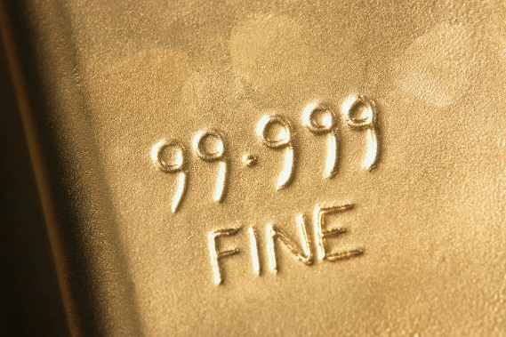


The Results of Greed: What Greed Steals From Its Victims
Third, greed can rob one’s spiritual life. (Continued)
The Lord explains the proper attitude toward material possessions
Matthew 6:19-21: 19Lay not up for yourselves treasures upon earth, where moth and rust doth corrupt, and where thieves break through and steal: 20But lay up for yourselves treasures in heaven, where neither moth nor rust doth corrupt, and where thieves do not break through nor steal: 21For where your treasure is, there will your heart be also.

Slide 12
The Results of Greed: What Greed Steals From Its Victims
Third, greed can rob one’s spiritual life. (Continued)
Matthew 6:24-34 continues: 24No man can serve two masters: for either he will hate the one, and love the other; or else he will hold to the one, and despise the other. Ye cannot serve God and mammon. 25Therefore I say unto you, Take no thought for your life, what ye shall eat, or what ye shall drink; nor yet for your body, what ye shall put on. Is not the life more than meat, and the body than raiment? 26Behold the fowls of the air: for they sow not, neither do they reap, nor gather into barns; yet your heavenly Father feedeth them. Are ye not much better than they? 27 Which of you by taking thought can add one cubit unto his stature? 28And why take ye thought for raiment? Consider the lilies of the field, how they grow; they toil not, neither do they spin: 29And yet I say unto you, That even Solomon in all his glory was not arrayed like one of these. 30Wherefore, if God so clothe the grass of the field, which to day is, and to morrow is cast into the oven, shall he not much more clothe you, O ye of little faith? 31Therefore take no

Slide 13
The Results of Greed: What Greed Steals From Its Victims
Matthew 6:24-34 (continued): thought, saying, What shall we eat? or, What shall we drink? or, Wherewithal shall we be clothed? 32(For after all these things do the Gentiles seek:) for your heavenly Father knoweth that ye have need of all these things. 33But seek ye first the kingdom of God, and his righteousness; and all these things shall be added unto you. 34Take therefore no thought for the morrow: for the morrow shall take thought for the things of itself. Sufficient unto the day is the evil thereof.
Edge out God=mammon; hate or love less
Ultimately, one has to answer the question of Matthew 16:26: “26For what is a man profited, if he shall gain the whole world, and lose his own soul? or what shall a man give in exchange for his soul?”

Slide 14


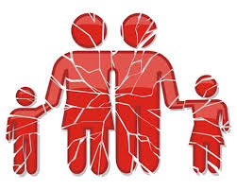
The Results of Greed: Greed Steals From Its Victims
Fourth, greed destroys one’s family.
Greed results in such a selfish attitude that it contagiously spreads.
Proverbs 15:27 (NKJV) explains, “He who is greedy for gain troubles his own house, But he who hates bribes will live.”
Most individuals start out their career working to help their families.
Only when greed, that whatever it takes attitude, consumes an individual that they become devoured by the want for more, and neglect their family and service to God.
Greed steals one’s real purpose as a desire for money or possessions become one’s focus.
Does a status symbol of a car really matter? Does the bigger house make one happy? Does the ring make for joy?

Slide 15

The Results of Greed: What Greed Steals From Its Victims
Fifth, greed robs one of their integrity.
Proverbs 28:19-20 explains, “19He that tilleth his land shall have plenty of bread: but he that followeth after vain persons shall have poverty enough. 20A faithful man shall abound with blessings: but he that maketh haste to be rich shall not be innocent.”
Again, Solomon advises labor. If one follows after the vain, get rich, greedy people; then Solomon warns that poverty is coming.
Solomon also teaches that one in a hurry to get rich will be guilty.
The justifications are easy to make.
“It’s just a little lie.
“It won’t hurt anyone.”
“So I missed church, I really need the money.”
“This will help so many once I get this going.”

Slide 16


The Results of Greed: Greed Steals From Its Victims
Fifth, greed robs one of their integrity.
God also warns the student of His word about the need to treat those who work for you with appreciation and not deceitfully.
Proverbs 3:27 explains, “Do not withhold good from those to whom it is due, When it is in the power of your hand to do so.”
The small loss of integrity comes in so many forms. Suddenly, all integrity can be lost.
Proverbs 28:6 instructs, “Better is the poor who walks in his integrity Than one perverse in his ways, though he be rich.”

Slide 17

The Results of Greed: What Greed Steals From Its Victims
Lastly, greed gives one a false sense of security.
In the United States, despite the efforts of some, most of the currency reads “In God We Trust.”
Money, power, fame – all that greed offers fails quickly. Greed’s companions seems so strong and comforting, but they can quickly fly away.
Proverbs 11:28-30 explains, “He that trusteth in his riches shall fall: but the righteous shall flourish as a branch. 29He that troubleth his own house shall inherit the wind: and the fool shall be servant to the wise of heart. 30The fruit of the righteous is a tree of life; and he that winneth souls is wise.”
Christ in the parable of the seeds and the soils in Matthew 13:22 warns that the seed that fell in the thorny ground was those who heard the word but the care of this world and the deceitfulness of riches choked out the word.
Confidence in money blinds us to our true dependence on God.

Slide 18
The Results of Greed: What Greed Steals From Its Victims
First, greed steals one’s life.
Second, greed results in financial disaster.
Third, greed can rob one’s spiritual life.
Fourth, greed destroys one’s family.
Fifth, greed robs one of their integrity.
Lastly, greed gives one a false sense of security.

Slide 19
Discussion
Greed is spiritual blinder.
What are the signs and symptoms of “greed” in my life?
Someone suggested Foxworthy style:
If ______________________ , you might be greedy.

Slide 20
Success Without Greed
One can be successful without greed.
First, be diligent and get to work.
Apply God’s word to life and be persistent.
Do not let greed compromise one’s values, purposes, or priorities.
Work, but do not become a workaholic, neglecting more important parts of life.
One must focus on achieving a purpose without compromising.
One cannot focus on money. One can ambitiously achieve without greed.

Slide 21

Success Without Greed
First, be diligent and get to work.
Proverbs 14:23 advises, “In all labor there is profit, But idle chatter leads only to poverty.”
Labor is the road to financial success, not chasing quick wealth.
If one works, especially at something they enjoy, success is in the process. The extra bonus of economic blessing often comes on its own.
In other words, work hard at something that you love to do and enjoy. If you do that, focusing on doing well, you will profit.

Slide 22
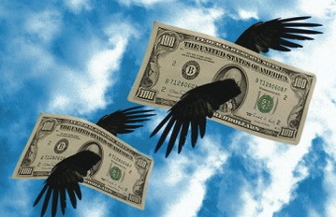

Success Without Greed
Second, do not try to get rich.
Proverbs 23:4-5 clarifies, “4Labour not to be rich: cease from thine own wisdom. 5Wilt thou set thine eyes upon that which is not? for riches certainly make themselves wings; they fly away as an eagle toward heaven.“
Perhaps, the best illustration of this is the lottery.
Millions will play and only one will win. Most lose.
These people are violating God’s principle of labor.
The lottery is a theft by consent program.
People often defend gambling under the guise that if they lose it will help some project in the state. If one really wants to help a particular project, then a donation is appropriate, not a lottery ticket.
A friend of mine calls the lottery a “stupid tax.”
“Do not try to get rich” does not prohibit achieving financial security or success. It does prohibit the love of or improper attitude toward riches.

Slide 23
Success Without Greed
A third help in success without greed is to focus on helping others.
Proverb 14:21 teaches, “He who despises his neighbor sins; But he who has mercy on the poor, happy is he.” Further 14:31 notes, “He who oppresses the poor reproaches his Maker, But he who honors Him has mercy on the needy.”
Proverbs 28:27 encourages to help those who are in need: “He who gives to the poor will not lack, But he who hides his eyes will have many curses.”
Psalms 37:21 explains, “The wicked borroweth, and payeth not again: but the righteous sheweth mercy, and giveth.”
If one focuses on giving generously to those who have need, then they often act to squash greed.
What one truly wants in life is not the new boat or piles of green-inked paper with pictures of dead presidents, but one wants fulfillment and joy.

Slide 24

Success Without Greed
A third help in success without greed is to focus on helping others. (Continued)
Hopefully, Christians seek happiness by trying to be pleasing Jehovah.
Greed and materialism will not fill that hole no matter how much advertisers and Madison Avenue tells society that it will.
Serving God does provide that joy and fulfillment beyond carnally-minded people’s understanding.
Proverbs 21:25-26 explains, “25The desire of the slothful killeth him; for his hands refuse to labour. 26He coveteth greedily all the day long: but the righteous giveth and spareth not.”
Paul in 1 Timothy 6:17-19 was inspired by the Holy Spirit to command: 17Charge them that are rich in this world, that they be not highminded, nor trust in uncertain riches, but in the living God, who giveth us richly all things to enjoy; 18That they do good, that they be rich in good works, ready to distribute, willing to communicate; 19Laying up in store for themselves a good foundation against the time to come, that they may lay hold on eternal life.
Ephesians 4:38 “Let him who stole steal no longer, but rather let him labor, working with his hands what is good, that he may have something to give him who has need.”

Slide 25
Success Without Greed
A fourth guide for success without greed is seek to serve God’s purposes.
Many times the scriptures warn Christians to avoid those who are covetous, knowing they will not inherit the kingdom of God (See Romans 1:29, 13:9, 1 Corinthians 5:11, Ephesians 5:3-5).
Nevertheless, greed is powerful. It is easy to become ensnared and infected by greed.
Christians must put away the idolatry of greed and covetousness, and seek to live a life for Christ.
Colossians 3:2-5 teaches: If ye then be risen with Christ, seek those things which are above, where Christ sitteth on the right hand of God. 2Set your affection on things above, not on things on the earth. 3For ye are dead, and your life is hid with Christ in God. 4When Christ, who is our life, shall appear, then shall ye also appear with him in glory. 5Mortify therefore your members which are upon the earth; fornication, uncleanness, inordinate affection, evil concupiscence, and covetousness, which is idolatry:

Slide 26
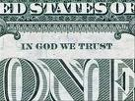

Success Without Greed
A fourth guide for success without greed is seek to serve God’s purposes.
Hebrews 13:5 admonishes: 5Let your conversation be without covetousness; and be content with such things as ye have: for he hath said, I will never leave thee, nor forsake thee.
Christians must put their trust in God.
What if something close to that was printed on the money to help people remember?

Slide 27
Success Without Greed
A fourth guide for success without greed is seek to serve God’s purposes.
Jesus’ teaching in Luke 12:15-21 helps one to understand that they need to seek God’s purposes above the things of this life:
15And he said unto them, Take heed, and beware of covetousness: for a man’s life consisteth not in the abundance of the things which he possesseth. 16And he spake a parable unto them, saying, The ground of a certain rich man brought forth plentifully: 17And he thought within himself, saying, What shall I do, because I have no room where to bestow my fruits? 18And he said, This will I do: I will pull down my barns, and build greater; and there will I bestow all my fruits and my goods. 19And I will say to my soul, Soul, thou hast much goods laid up for many years; take thine ease, eat, drink, and be merry. 20But God said unto him, Thou fool, this night thy soul shall be required of thee: then whose shall those things be, which thou hast provided? 21So is he that layeth up treasure for himself, and is not rich toward God.

Slide 28
Success Without Greed
Fifth, to prevent greed, the Christian must recognize the riches they enjoy as a faithful servant of God.
Sometimes, greed comes from the desperation and despair of debt. Eg wicked servant in Mt 18:24-34
The Christian must focus on the spiritual first. The great debt of sin has been covered by the Christ.
The Christian knows they have a greater inheritance, that their Father’s house has many mansions, and they seek a crown of righteousness and the treasure of eternal life.
The Christian was redeemed by the precious blood of Christ.
1 Peter 1:17-19 explains: “And if you call on the Father, who without partiality judges according to each one’s work, conduct yourselves throughout the time of your stay here in fear; 18knowing that you were not redeemed with corruptible things, like silver or gold, from your aimless conduct received by tradition from your fathers, 19but with the precious blood of Christ, as of a lamb without blemish and without spot.”

Slide 29
Success Without Greed
Fifth, to prevent greed, the Christian must recognize the riches they enjoy as a faithful servant of God.
The Christian knows that “God shall supply all you need according to his riches in glory by Christ Jesus” (Philippians 4:19).
The full assurance of understanding is great riches to the Christian.
Colossians 2:2-3 explains, “2that their hearts may be encouraged, being knit together in love, and attaining to all riches of the full assurance of understanding, to the knowledge of the mystery of God, both of the Father and of Christ, 3in whom are hidden all the treasures of wisdom and knowledge.” (See also 1:27).
Paul calls this the “unsearchable riches of Christ” in Ephesians 3:8.

Slide 30
Success Without Greed
Fifth, to prevent greed, the Christian must recognize the riches they enjoy as a faithful servant of God.
Ephesians 1:7 makes the point, “In Him we have redemption through His blood, the forgiveness of sins, according to the riches of His grace.”
The Christian must be strengthened by this understanding.
Ephesians 3:16-17 instructs, “that He would grant you, according to the riches of His glory, to be strengthened with might through His Spirit in the inner man, 17that Christ may dwell in your hearts through faith; that you, being rooted and grounded in love.”
Further, one can consider the relationship of the temporal to the eternal.
Jesus taught in Matthew 19:29, “And everyone who has left houses or brothers or sisters or father or mother or wife or children or lands, for My name’s sake, shall receive a hundredfold, and inherit eternal life.”
Where are your eyes focused?

Slide 31
Success Without Greed
First, be diligent and get to work.
Second, do not try to get rich.
A third help in success without greed is to focus on helping others.
A fourth guide for success without greed is seek to serve God’s purposes.
Fifth, to prevent greed, the Christian must recognize the riches they enjoy as a faithful servant of God.

Slide 32
Greed - Summary
Greed as a lust of the eye is a spiritual blinder that Satan frequently uses.
Greed grows out of covetousness and is idolatry. Some might even define the words similarly. Some like the terms “materialism” or “mammon.” No matter the terminology, it is dangerous.
It can rob one of their life, yield financial disaster, steal one’s spiritual life, destroy one’s family, and cheat one of their integrity, even though it gives a false sense of security.
Achieving without greed requires work and labor. One should not focus on getting rich or money, but rather on helping others in need and serving God’s purpose.
Greed blinds us spiritually, and it is not be a part of the godly life.

Slide 33
Greed - Summary
Timothy 6:6-12 summarizes well: 6But godliness with contentment is great gain. 7For we brought nothing into this world, and it is certain we can carry nothing out. 8And having food and raiment let us be therewith content. 9But they that will be rich fall into temptation and a snare, and into many foolish and hurtful lusts, which drown men in destruction and perdition. 10For the love of money is the root of all evil: which while some coveted after, they have erred from the faith, and pierced themselves through with many sorrows. 11But thou, O man of God, flee these things; and follow after righteousness, godliness, faith, love, patience, meekness. 12Fight the good fight of faith, lay hold on eternal life, whereunto thou art also called, and hast professed a good profession before many witnesses.

Slide 34
Greed: For Discussion
Jude 11 warns those who “have run greedily in the error of Balaam for profit.” Who was Balaam (see Numbers 22)? What did he do? What was his error? What were the results of his greed?
What other examples of greed can you think of from God’s word? What was the result of the greed?
In Luke 11:38, what did Jesus teach the Pharisees about their “greed and wickedness?”
How can the children of Light apply this discussion?
What should Christians practice instead of greed?

